Slide 1


1. To learn to use the words and expressions:
the day before yesterday, the day after tomorrow, weekday, look after
--What’s today?
--It’s Monday the 14th.
2. To review how to give and refuse invitations

Slide 2


prepare for …
1) 为……做准备 ______________
2) 得了流感 _____________
3) 见朋友 _______________
4) 当然，我愿意去。 _______________
5) 太多作业 ___________________
have the flu
meet the friend
Sure. I’d love to.
too much homework
Sorry. I’m not available/ free.
6) 对不起，我没空。 __________________________
7) 直到……才 _____________________
8) 闲逛 _____________________
9) accept反义词 _____________________
not … until
hang out
refuse

Slide 3
Make an invitation to your partner. You may use the expressions below.
Days | Activities | Accept/Refuse
tomorrow the day after tomorrow weekday weekend | play tennis go hiking hang out play soccer | I’d love to. prepare for the math exam help my mom not available/free

Slide 4

Unit 9

Slide 5
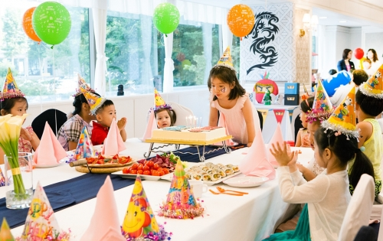
Unit 9
Can you come to my party?

Slide 6
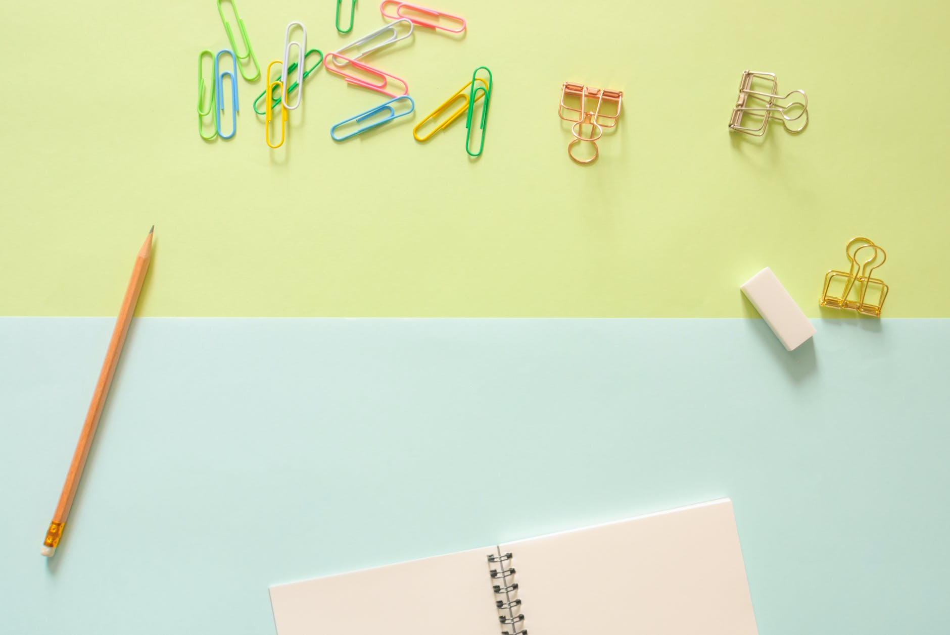


Slide 7

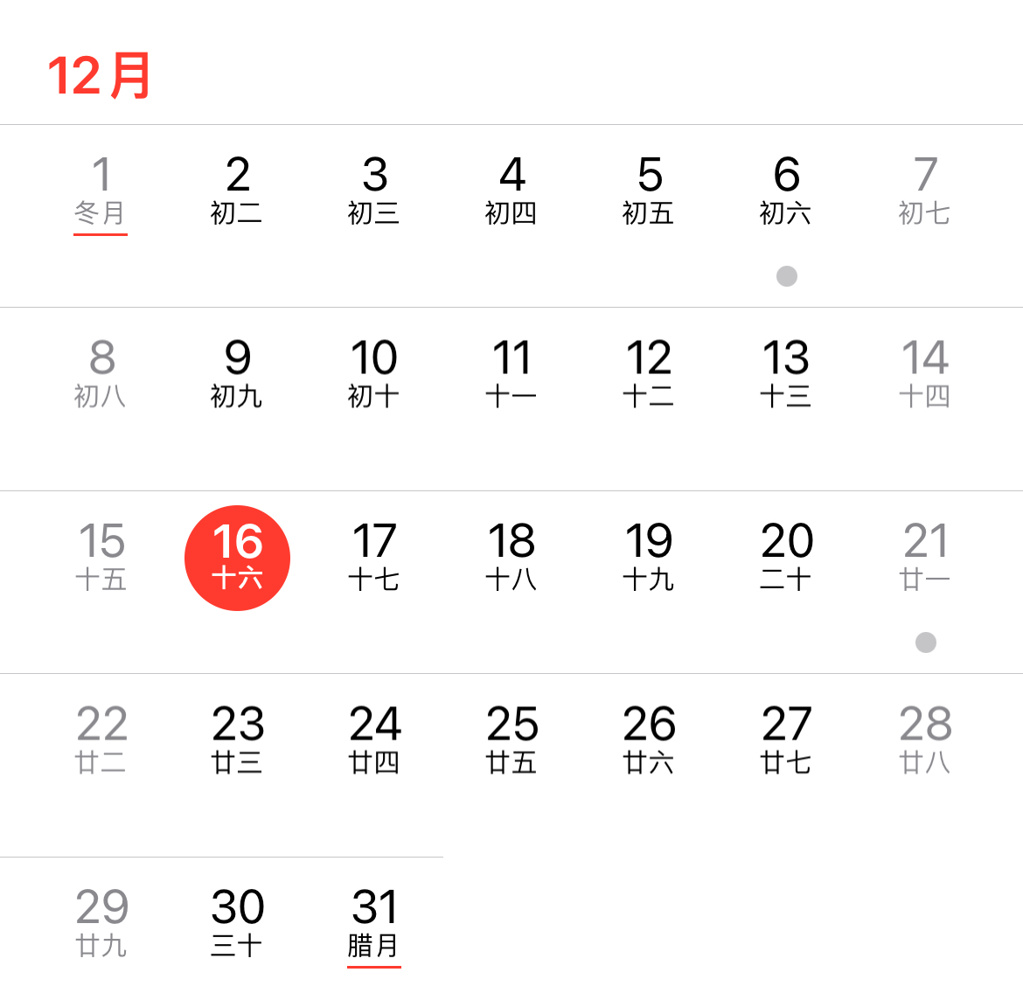
Lead-in
Ask and answer questions.
calendar
n
—What’s the date today?(月、日)
—It’s December the 16th.
—What day is it today?(星期)
—It’s Monday.
—What’s today?(星期、日)
—It’s Monday the 16th.
n.日历；日程表

Slide 8


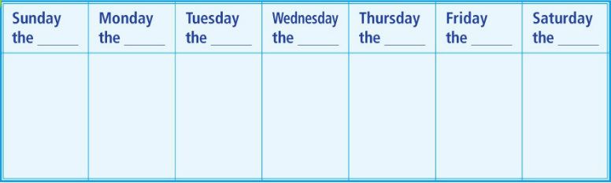
Write the dates for this week on the calendar.
What’s today?
15th
16th
17th
18th
19th
20th
21st
today

Slide 9
Choose the correct words from the word bank.
15th
16th
17th
18th
19th
20th
21st
the day
after
tomorrow
yesterday
today
tomorrow
weekend
weekday
weekday
weekday
weekday
weekday
weekend
Saturday the 14th
Word Bank:
today tomorrow yesterday
the day before yesterday 前天
the day after tomorrow 后天
weekday n.工作日 weekend
the day
before
yesterday

Slide 10




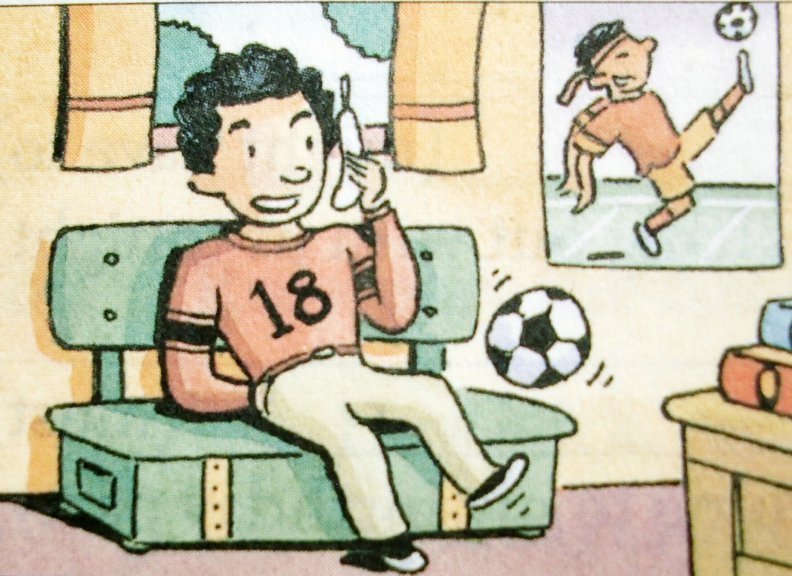
Listen. Can Vince play tennis with Andy? Circle Yes or No.
Yes No
Andy

Slide 11

Listen again. Match Vince’s activities with the days.
Vince’s activities | Days
____ play soccer | a. today b. tomorrow c. the day after tomorrow
____ go to the doctor
____ study for a test
____ have a piano lesson
____ look after his sister
b
a
a
b
c

Slide 12
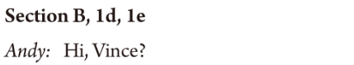
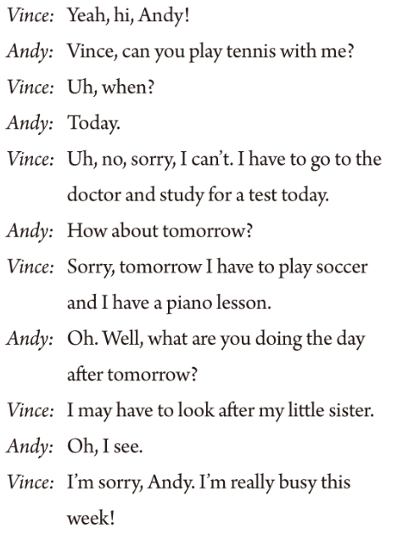
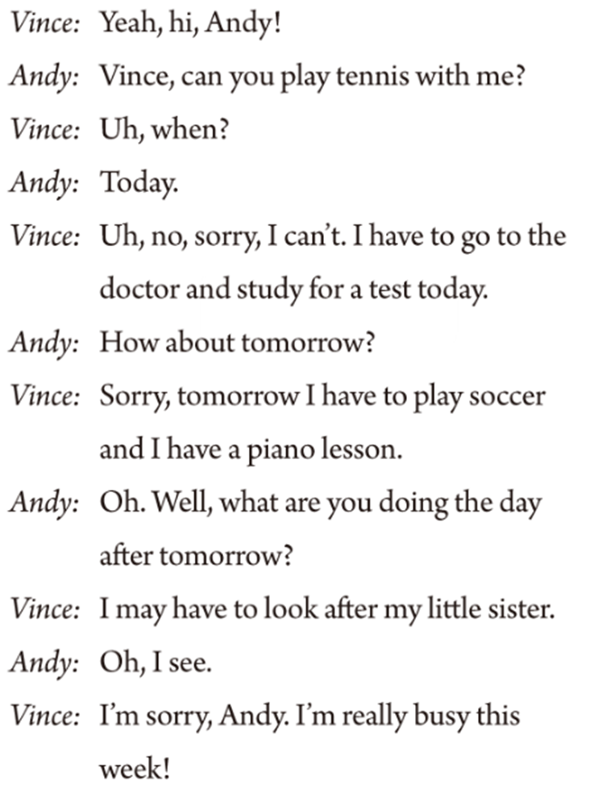

Slide 13

Complete the sentences below.
Use the words in brackets to help you.
Can you play tennis with me on Saturday afternoon?
1. Inviting: ______________________________ (can/play tennis)
Accepting: __________________________________________
2. Inviting: ____________________________________________ (would like to/go to the movies)
Refusing: __________________________________________
Reason: ____________________________________________
(might have to)
Sure, that sounds great.
Would you like to go to the movies with me tonight?
Sorry, I can’t.
I might have to go out with my parents.

Slide 14
Can you hang out with us tonight?
3. Inviting: __________________________________________
(can/hang out with us tonight)
Refusing: _________________________________________
Reason: ___________________________________________
(must)
4. Inviting: __________________________________________ (would like to / come to my birthday party)
Accepting: ________________________________________
Sorry, I am not free.
I must study for a test.
Would you like to come to my birthday party?
Sure, I’d love to.

Slide 15


Complete the answers with might and one of the phrases in the box.
watch TV, on the weekend, my cousin,
visit my grandparents, practice the violin
1. A: What are you going to do on Saturday?
B: I’m not sure. I might ________________________.
visit my grandparents/...
2. A: What are you planning to do after school?
B: I don’t know. ________________.
3. A: When will you finish the science homework?
B: _____________________________________________.
I might watch TV/...
I might finish it on the weekend

Slide 16
watch TV, on the weekend, my cousin,
visit my grandparents, practice the violin
4. A: Who are you going to the movies with?
B: ______________________________________.
5. A: Are you free to come to my place on Saturday?
B: ______________________________________________.
I might go with my cousin
I might have to practice the violin/...

Slide 18


-- What day is (it) today?
-- It’s Monday.
-- What’s the date today?
-- It’s December 14th.
-- What’s today?
-- It’s Monday the 14th.

Slide 19

Write these words below the correct dates on the calendar in 1a.
today tomorrow yesterday
the day before yesterday
the day after tomorrow
weekday weekend

Slide 20
weekday
Sun. | Mon. | Tue. | Wed. | Thur. | Fri. | Sat.
 |  |  |  |  |  | 1
2 | 3 | 4 | 5 | 6 | 7 | 8
9 | 10 | 11 | 12 | 13 | 14 | 15
16 | 17 | 18 | 19 | 20 | 21 | 22
23 | 24 | 25 | 26 | 27 | 28 | 29
yesterday
tomorrow
today
the day before yesterday前天
the day after tomorrow 后天

Slide 21

— What day is (it) today?
— It’s Tuesday.
1. — What day was (it) yesterday?
— It was Monday.
2. — What day is (it) tomorrow?
— It’s Wednesday.
3. — What day is (it) the day after tomorrow?
— It’s Thursday.

Slide 22
— What’s the date today?
— It’s October 23rd.
1. — What was the date yesterday?
— It was October 22nd.
2. — What’s the date tomorrow?
— It’s October 24th.
3. — What’s the date the day after tomorrow?
— It’s October 25th.

Slide 23

Ask and answer questions about the days in 1a.
It’s Monday the 14th.
What’s today?
今天几号，星期几？
What was yesterday?
It was …

Slide 24
What’s tomorrow?
It’s …
What’s the day after tomorrow?
It’s …

Slide 25


Look at the picture and think about:
What kind of activities does he like?
Why is he making a telephone call?

Slide 27
Fill in the blanks. Use the information form 1d.
Vince _________________ play tennis with Andy today. He ____________________ and study for a test. Tomorrow, he ___________________ and ___________________. And he __________________ look after his little sister ________________________.
can’t
has to go to the doctor
has to play soccer
has a piano lesson
may have to
the day after
tomorrow

Slide 28


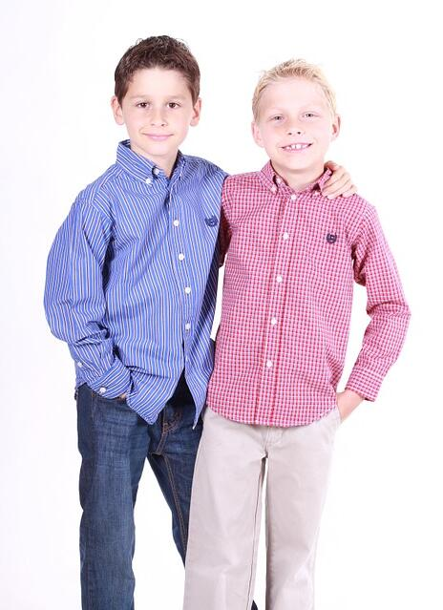
Student A is Andy and Student B is Vince. Andy, invite Vince to play tennis.
Hi, Vince. Can you play tennis with me?
When?
Sorry, I can’t. I’m really busy this week. But how about next week?
Today.
That would be great!

Slide 29


1. the day after tomorrow 后天
the day before yesterday 前天
have a piano lesson 上钢琴课
look after 照料; 照顾
2. -- What’s today?
-- It’s Monday the 14th.
3. -- Can you play tennis with me?
-- Sorry, I can’t. I have to / may…

Slide 30


根据汉语意思，完成英语句子，每空一词。
1. Lucy前天在街上遇到了她的好友Anna。
Lucy met her good friend Anna in the street ________ ________ ________ ________.
2. 我父母不在家，我得帮忙照顾我妹妹。
My parents are not at home and I have to help _______ _______ my sister.
the
day before yesterday
look after

Slide 31
3. 工作日期间我通常十点前上床睡觉。
On _________ I’m usually in bed by ten o'clock.
4. 我们决定后天动身去北京。
We decided to leave for Beijing __________ __________ __________ __________.
weekdays
the day
after tomorrow

Slide 32


Make a list of the kinds of parties you know.
Preview the messages on Page 69.

Slide 33
